Slide 1

RENTAL MARKET STATS – JULY 2021
05 Aug 2021 – 09:00 – 10:00
presented by

Slide 2
Overview
Rental Market Stats – July 2021

Slide 3
Rental Market Stats – July 2021
Market Facts (& Resources)
  Supply & Demand
  Rental
Affordability Stats
How to Use the Stats

Slide 4
Market Stats & Resources
Rental Market Stats – July 2021

Slide 5
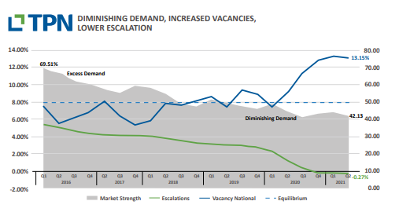
TPN Vacancy Survey – Q2/2021
Link: https://www.tpn.co.za/Group/Home/Media

Slide 6
TPN Vacancy Survey – Q2/2021
Link: https://www.tpn.co.za/Group/Home/Media
Highlights
  Estate Agent’s Market Assessment
  Location, location, location Gauteng – home to half the rental population
  Western Cape - home to the best paying tenants
  Kwazulu-Natal – home to winning constitutional court tenants
  Eastern Cape – home to the market most in demand

Slide 7
Stats SA – May ’21 CPI Report
Link - Twitter: https://twitter.com/johannbiermann1/status/1407952733563408384
  Rental inflation has completely collapsed. It is currently at the lowest level on record (since Jan '08). Gauteng is actually experiencing deflation, while the majority of the provinces are seeing year on year price increases of 2% or lower.
Source: Stats SA, May '21 CPI Report

Slide 8
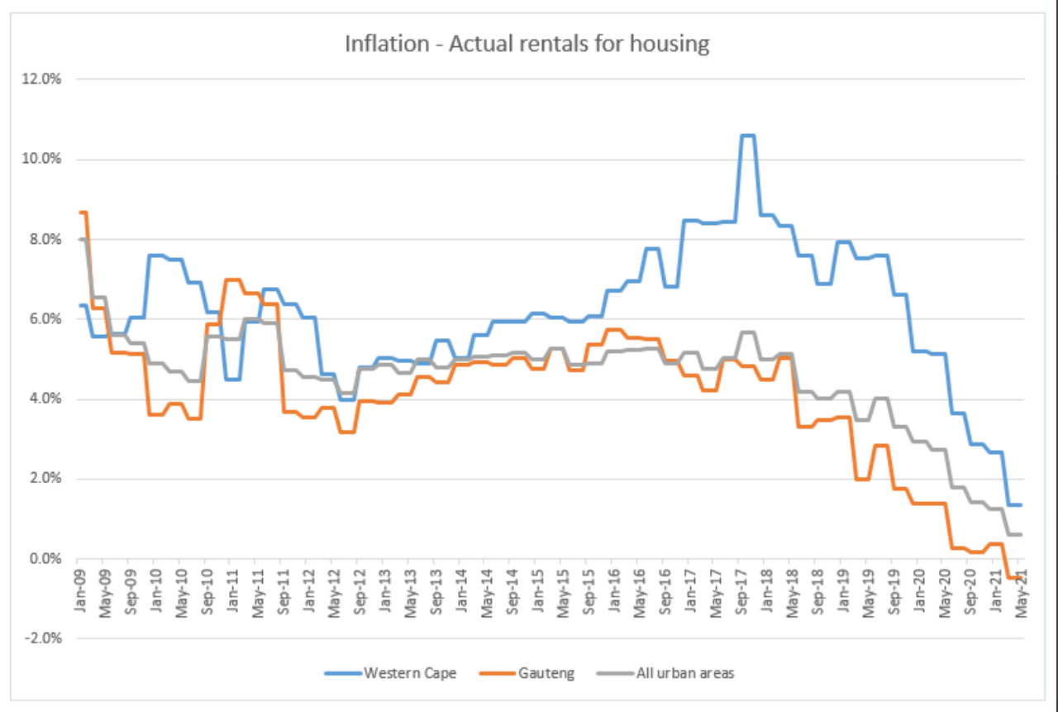
Stats SA – May ’21 CPI Report

Slide 9
Property Party Loses its fizz as tenants hold sway
Property party loses its fizz as tenants hold sway (Source: BusinessLive dd 11/7/2021)
It is a tenant’s market, with an oversupply of vacant properties driving down rental prices. Tenants are thus shopping around for a better deal, with price their most important consideration, closely followed by security and then proximity to work, schools and shops.
Nationally, vacancy rates have stabilised at 13.2%. A demand rating of 53% indicates that tenants are still in the market but in reduced numbers, while a supply rating of 68.8% means landlords are having to compete for tenants.

Slide 10
Property Party Loses its fizz as tenants hold sway/contd
landlords are reporting no interest in a property until the price is dropped and re-advertised.
Landlords reported a vacancy rate of 14.29%
Estate agents have a slightly more optimistic view of the market, arguably because they have the benefit of foot traffic or more property adverts to entice the reduced number of tenants. Their perception of the market indicates slightly more tenant demand than landlords perceive, and a lower vacancy rate.

Slide 11
Property Party Loses its fizz as tenants hold sway/contd
Regional Info
  Gauteng:
    is not yet showing signs of recovery
    home to half the country’s rental population
    the demand rating dipping below 50, accompanied by a persistently strong supply rating, which combined has resulted in a severely restricted market strength.
    The vacancy rate has recovered from 13.8% in the first quarter to 12.4% in the second quarter
    Of concern is Sandton, which has a high 26.7% vacancy rate

Slide 12
Property Party Loses its fizz as tenants hold sway/contd
Regional Info/contd.
  Western Cape:
    neither landlords nor estate agents have felt a recovery in the Western Cape market, where
    tenant demand has deteriorated
    This is the first time the Western Cape’s vacancy rate of 14.4% has breached double digits

Slide 13
Property Party Loses its fizz as tenants hold sway/contd
Regional Info/contd.
  KZN:
    landlords and estate agents perceive a stable supply rating, indicating that
    the potential shock of the pandemic on market strength was cushioned by a recent history of limited supply of new rental property stock.
    Though the demand rating has diminished over time, it continues to support sufficient demand for the available supply and has been able to maintain a positive escalation
    Vacancies in the North Coast area have increased to 17.2% due to limited new supply.

Slide 14
Property Party Loses its fizz as tenants hold sway/contd
Affordability
  tenant payment recovery is painfully slow
  78.38% of tenants are back in good standing for the first quarter of 2021
  Tenants in good standing are those whose accounts, including any arrears, have been settled in full by the 30th of the month
  Tenants in arrears with a salary are still recovering from their partial, full or temporary loss of earnings during the hard lockdown in the second quarter of 2020.
  A total of 13.9% of tenants are stuck in the partial payments category.

Slide 15
Escalating Municipal Charges
Rental Market Stats – July 2021

Slide 16
Escalating Municipal Charges
What you need to know about SA's rapidly escalating municipal charges (Source: Property24, ss 21/6/2021)
  "At a time when many people across the country are still feeling the ripple effects of the Covid-19 pandemic characterised as it was by job losses, growing unemployment and financial insecurity, property owners and tenants in South Africa will be hard hit in the coming months by double digit escalations in municipal usage charges.”
  These escalating costs are not only impacting property owners but also tenants given that in recent years, municipal usage charges – even for sectional title properties - have increasingly been passed on to property tenants with new lease agreements now typically including itemised charges

Slide 17
Escalating Municipal Charges
What you need to know about SA's rapidly escalating municipal charges (Source: Property24)/contd.
  'Negative escalations, market under pressure’ - In previous years, rental escalations – which are typically in line with inflation - have come under pressure as a result of low GDP. The Covid-19 pandemic exacerbated the situation given that most people’s incomes have not grown in the past year with the result that rental increases have been very low. In some instances, says Dickens, escalations have even morphed into negative escalations.

Slide 18
Sources
Rental Market Stats – July 2021

Slide 19
More Sources
We've dropped over the edge! - https://blog.tpn.co.za/2021/03/we-went-over-cliff.html
TPN Vacancy Survey 2021 Q2 - https://www.tpn.co.za/Group/Home/Media
Landlords report higher vacancies than estate agents - https://blog.tpn.co.za/2021/06/landlords-report-higher-vacancies-than.html

Slide 20
Sources to Follow
TPN Facebook Page - https://www.facebook.com/TPNCreditBureau/
Property24 Blog - https://www.property24.com/articles/news/latest-news

Slide 21
How to Use the Stats
Rental Market Stats – July 2021

Slide 22
How to Use the Stats
Rental Appraisal Letter
Blog Articles
  Share in Landlord Newsletters
  Share on social media
  Become the ‘Go To’ Rental Expert!

Slide 23
Would you like Newsletter / Blog Articles
Rental Market Stats – July 2021

