Slide 1








TENANTING
RENTAL PROPERTIES
IN A TOUGH RENTAL MARKET
presented by
My training is proudly recommended & endorsed by the following organisations. . .

Slide 2
The Strategy - Overview
MasterClass – Tenanting Properties in a Tough Rental Market
Shaun Luyt | Residential Property Rental Procedures, Training & Advice | ShaunLuyt.co.za

Slide 3
Overview of Strategy
Adapt
Market Analysis
Rental Appraisal
Marketing
Analyse Results
Shaun Luyt | Residential Property Rental Procedures, Training & Advice | ShaunLuyt.co.za
Notes:
MARKET ANALYSIS – The Market in General, taking into account the supply & demand drivers of the residential rental market. The market is a given – we need to work within it.
RENTAL APPRAISL – Assessment of the subject property within the current market conditions
MARKETING:
ANALYSE THE RESULTS – Review the marketing and the numbers, i.e factual information, determine where the ‘problem’ or ‘blockage’ is and then adapt
FEEDBACK LOOPS - Analyse Results & Adapt Marketing = Marketing Feedback Loop

Slide 4
Importance of the Feedback Loop
  Continuing do so the same thing
  & expecting a different result?
Definition of Insanity
To get a different result,
We need to change what we are doing
Shaun Luyt | Residential Property Rental Procedures, Training & Advice | ShaunLuyt.co.za

Slide 5
The Team Approach
MasterClass – Tenanting Properties in a Tough Rental Market
Shaun Luyt | Residential Property Rental Procedures, Training & Advice | ShaunLuyt.co.za

Slide 6
The Importance of the Team Approach
Adapt
Market Analysis
Rental Appraisal
Marketing
Analyse Results
Landlord
Shaun Luyt | Residential Property Rental Procedures, Training & Advice | ShaunLuyt.co.za
Notes:
Marketing = Team Effort = Agent’s Market Knowledge, Expertise & Experience + Landlord’s Willingness to Take Decisions When Required to Do So
Agent needs to empower the Landlord with the information they require to take the right decision – specifically facts
CONTINUOUS COMMUNICATION
“Price Counselling” ?????
I’m going to spend quite a bit of time on ‘the basics’ – not for your benefit, but to equip you with some ‘tools’, strategies, approaches and diagrams that you may find helpful to educate your landlords

Slide 7
Market Analysis
MasterClass – Tenanting Properties in a Tough Rental Market
Shaun Luyt | Residential Property Rental Procedures, Training & Advice | ShaunLuyt.co.za

Slide 8
Market Analysis
Adapt
Market Analysis
Rental Appraisal
Marketing
Analyse Results
Shaun Luyt | Residential Property Rental Procedures, Training & Advice | ShaunLuyt.co.za
Notes:
Market forces, i.e. the nature of the rental market
We probably know this – but remember the team approach!

Slide 9
The Team Approach
Adapt
Market Analysis
Rental Appraisal
Marketing
Analyse Results
Landlord
Shaun Luyt | Residential Property Rental Procedures, Training & Advice | ShaunLuyt.co.za
Notes:
We need to get the Landlord on the same page as this – the first ‘Team Meeting’
If we don’t ‘educate’ the Landlord (i.e. price counselling) WE won’t get the result that WE need – i.e. the Landlord to take the ‘right’ decision when we need them to
The only way to get the Landlord to take the right decision is to empower them with knowledge and factual information (analysis & feedback loop)

Slide 10
Nature of the Rental Market
MasterClass – Tenanting Properties in a Tough Rental Market
Shaun Luyt | Residential Property Rental Procedures, Training & Advice | ShaunLuyt.co.za

Slide 11
Nature of the Rental Market
Rental Market Drivers
  Supply
  Demand
  ‘balance’ / imbalance
Demand vs ‘Qualified Demand’
Summary
  Driver = ‘Qualified Demand” or Demand
Shaun Luyt | Residential Property Rental Procedures, Training & Advice | ShaunLuyt.co.za

Slide 12
The Current Market
MasterClass – Tenanting Properties in a Tough Rental Market
Shaun Luyt | Residential Property Rental Procedures, Training & Advice | ShaunLuyt.co.za

Slide 13
The Current Market
In flux & unique
  Uncertainty
  Unsettled
Number of properties to rent
  Prospective Tenant have more choice
  ‘Tenant’s’ market
Uncertainty
  Caution!
Shaun Luyt | Residential Property Rental Procedures, Training & Advice | ShaunLuyt.co.za

Slide 14
The Current Market / contd.
Consumers (prospective tenants)
  Financial pressure / uncertain financial position
  ‘Alternative’ arrangements
  Backlog of debt (repayment plans)
  Possible negative credit history
  Still living with ‘uncertainty’
  Increased tendency to ‘conservative financial decisions
Landlords
  Financial pressure / need income
  ‘holidays’ have come to an end
  May have arrears
  ‘Can’t afford’ to drop rent (?) / offer incentives
Shaun Luyt | Residential Property Rental Procedures, Training & Advice | ShaunLuyt.co.za

Slide 15
The Rental Appraisal
MasterClass – Tenanting Properties in a Tough Rental Market
Shaun Luyt | Residential Property Rental Procedures, Training & Advice | ShaunLuyt.co.za

Slide 16
The Rental Appraisal
Adapt
Market Analysis
Rental Appraisal
Marketing
Analyse Results
Landlord
Shaun Luyt | Residential Property Rental Procedures, Training & Advice | ShaunLuyt.co.za
Notes:
- Rental Appraisal – Focus on the subject property

Slide 17
Importance of the Rental Appraisal
Focuses on the subject property
Within the current market conditions
Landlord education
Latest competition
Shaun Luyt | Residential Property Rental Procedures, Training & Advice | ShaunLuyt.co.za
Notes:
Landlord education is the probably the most important purpose of this step
BUT
Given the fluidity of the current market, there is an equal value to acquaint/update ourselves on the competition, etc at this point in time

Slide 18
Updating ‘the Team Members’
Adapt
Market Analysis
Rental Appraisal
Marketing
Analyse Results
Landlord
Shaun Luyt | Residential Property Rental Procedures, Training & Advice | ShaunLuyt.co.za
Notes:
Written Rental Appraisal – factual, examples, real facts

Slide 19
Rental Appraisal
Written
Factual
Include
  Current Competition
  Recent Experience / examples (convert to %’s to quote)
  Summary of (general) market conditions
  Anecdotal reports
  Media reports (useful)
Shaun Luyt | Residential Property Rental Procedures, Training & Advice | ShaunLuyt.co.za
Notes:
Look at an example of the the Renta

Slide 20
Rental Appraisal
Template – LL001
Shaun Luyt | Residential Property Rental Procedures, Training & Advice | ShaunLuyt.co.za

Slide 21
Marketing
MasterClass – Tenanting Properties in a Tough Rental Market
Shaun Luyt | Residential Property Rental Procedures, Training & Advice | ShaunLuyt.co.za

Slide 22
The Rental Appraisal
Adapt
Market Analysis
Rental Appraisal
Marketing
Analyse Results
Landlord
Shaun Luyt | Residential Property Rental Procedures, Training & Advice | ShaunLuyt.co.za
Notes:
- Rental Appraisal – Focus on the subject property

Slide 23
Marketing Principles
MasterClass – Tenanting Properties in a Tough Rental Market
Shaun Luyt | Residential Property Rental Procedures, Training & Advice | ShaunLuyt.co.za

Slide 24
The Marketing Funnel
MasterClass – Tenanting Properties in a Tough Rental Market
Shaun Luyt | Residential Property Rental Procedures, Training & Advice | ShaunLuyt.co.za

Slide 25





Marketing Funnel Theory
Ad Views
Enquiries
Viewings
Applications
Recommended Applicant/s
Approved Applicant/s
Approved Applicant Paid
Approved Applicant Paid and Lease Signed
Shaun Luyt | Residential Property Rental Procedures, Training & Advice | ShaunLuyt.co.za
Notes:
Follow customer journey / experience
Interested people ‘get disqualified’ or abandon the process as they go through

Slide 26
Price Banding
MasterClass – Tenanting Properties in a Tough Rental Market
Shaun Luyt | Residential Property Rental Procedures, Training & Advice | ShaunLuyt.co.za

Slide 27

Current Competition
Tenants search in price bands
Price
The Market / Advertising Portal
Shaun Luyt | Residential Property Rental Procedures, Training & Advice | ShaunLuyt.co.za
Notes:
- Current competition = other properties in the same price band

Slide 28
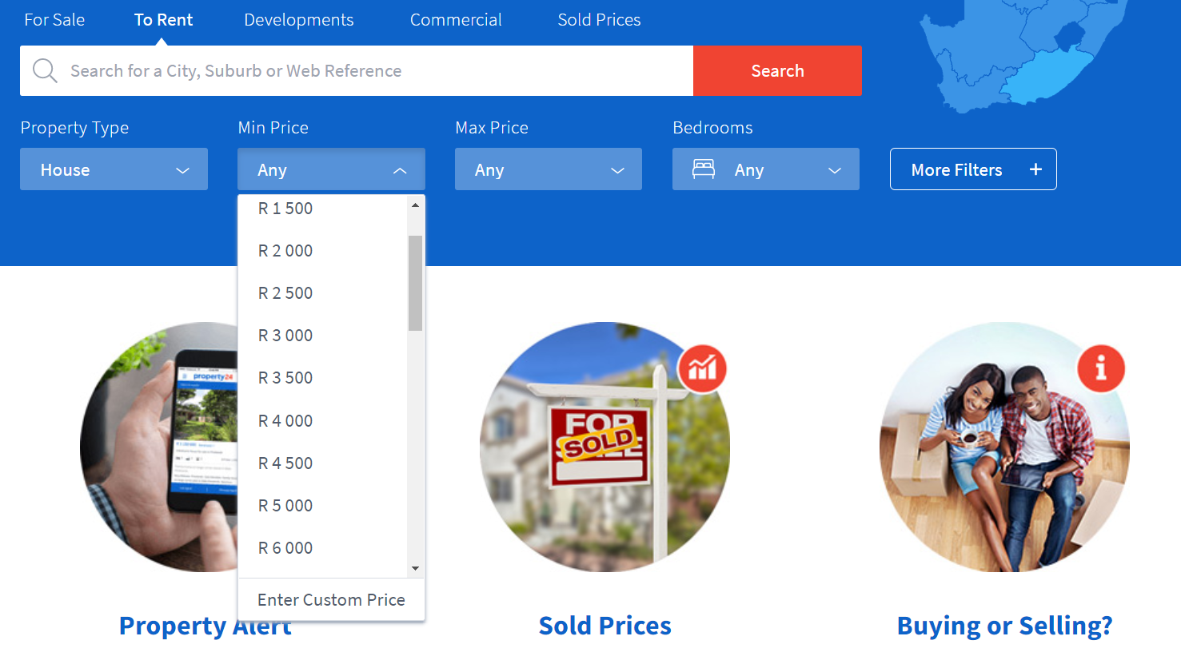
Price Bands
Property24.com
Shaun Luyt | Residential Property Rental Procedures, Training & Advice | ShaunLuyt.co.za

Slide 29
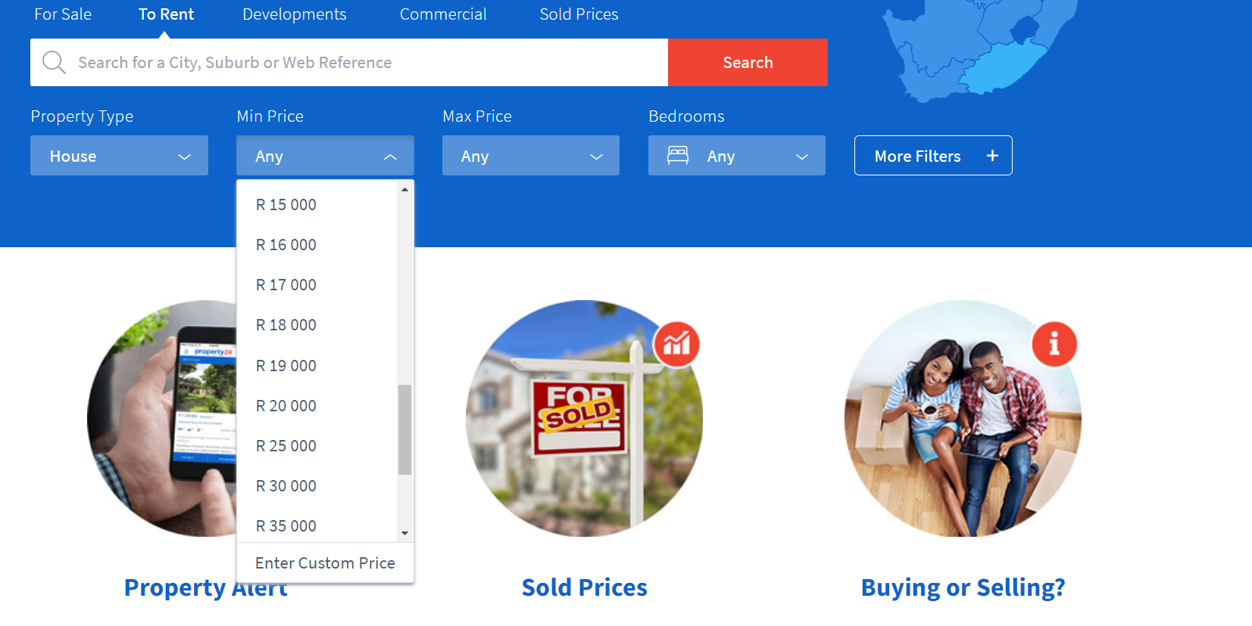
Price Bands
Shaun Luyt | Residential Property Rental Procedures, Training & Advice | ShaunLuyt.co.za

Slide 30
The Affordability Pyramid
MasterClass – Tenanting Properties in a Tough Rental Market
Shaun Luyt | Residential Property Rental Procedures, Training & Advice | ShaunLuyt.co.za

Slide 31
The Affordability Triangle & the Market
Tenants search in price bands
Price
The Market / Advertising Portal
Shaun Luyt | Residential Property Rental Procedures, Training & Advice | ShaunLuyt.co.za
Notes:
The Higher the price, the smaller the market
Lower price = more potential renters

Slide 32
The Affordability Pyramid
& Price Banding
MasterClass – Tenanting Properties in a Tough Rental Market
Shaun Luyt | Residential Property Rental Procedures, Training & Advice | ShaunLuyt.co.za

Slide 33
The Affordability Triangle & Price Bands
Price
The Market / Advertising Portal
Shaun Luyt | Residential Property Rental Procedures, Training & Advice | ShaunLuyt.co.za
Notes:
The Higher the price, the smaller the market
Lower price = more potential renters

Slide 34
The Affordability Triangle & Price Bands
Price
The Market / Advertising Portal
Shaun Luyt | Residential Property Rental Procedures, Training & Advice | ShaunLuyt.co.za
Notes:
The Higher the price, the smaller the market
Lower price = more potential renters

Slide 35
The Affordability Triangle & Price Bands
Price
The Market / Advertising Portal
Shaun Luyt | Residential Property Rental Procedures, Training & Advice | ShaunLuyt.co.za
Notes:
The Higher the price, the smaller the market
Lower price = more potential renters

Slide 36
Final Words . . . Marketing
Advertised rental
  What level to start at?
  What if the landlord wants too much?
Shaun Luyt | Residential Property Rental Procedures, Training & Advice | ShaunLuyt.co.za

Slide 37
Analyse Results
MasterClass – Tenanting Properties in a Tough Rental Market
Shaun Luyt | Residential Property Rental Procedures, Training & Advice | ShaunLuyt.co.za

Slide 38
Analyse Results
Adapt
Market Analysis
Rental Appraisal
Marketing
Analyse Results
Landlord
Shaun Luyt | Residential Property Rental Procedures, Training & Advice | ShaunLuyt.co.za
Notes:
- Rental Appraisal – Focus on the subject property

Slide 39
Analyse Results
Can only analyse what you measure
Can only adapt what you measure & review
Weekly Marketing review
  Monday/Tuesday
  Written report & recommendations to Landlord
  Follow up with telecon
What should you measure?
Shaun Luyt | Residential Property Rental Procedures, Training & Advice | ShaunLuyt.co.za

Slide 40
Analysing the Marketing Funnel
MasterClass – Tenanting Properties in a Tough Rental Market
Shaun Luyt | Residential Property Rental Procedures, Training & Advice | ShaunLuyt.co.za

Slide 41
Marketing Funnel Theory
Ad Views
Enquiries
Viewings
Applications
Recommended Applicant/s
Approved Applicant/s
Approved Applicant Paid
Approved Applicant Paid and Lease Signed
Shaun Luyt | Residential Property Rental Procedures, Training & Advice | ShaunLuyt.co.za
Notes:
Follow customer journey / experience
Interested people ‘get disqualified’ or abandon the process as they go through

Slide 42
Results Analysis
Measure the results
Determine the ‘sticking point’ / bottleneck / blockage
Shaun Luyt | Residential Property Rental Procedures, Training & Advice | ShaunLuyt.co.za

Slide 43
Example of a ‘blockage’
Ad Views
Enquiries
Viewings
Applications
Recommended Applicant/s
Approved Applicant/s
Approved Applicant Paid
Approved Applicant Paid and Lease Signed
Shaun Luyt | Residential Property Rental Procedures, Training & Advice | ShaunLuyt.co.za
Notes:
Blockage = Recommended Applications – People not understanding your application criteria
AND / OR Credit history issues

Slide 44
Example of a ‘bottleneck’
Ad Views
Enquiries
Viewings
Applications
Recommended Applicant/s
Approved Applicant/s
Approved Applicant Paid
Approved Applicant Paid and Lease Signed
Shaun Luyt | Residential Property Rental Procedures, Training & Advice | ShaunLuyt.co.za
Notes:
Blockage = Recommended Applications – People not understanding your application criteria
AND / OR Credit history issues

Slide 45
Weekly Analysis
What to measure?
Ad Views
Enquiries
Viewings
Applications
Recommended Applicant/s
Approved Applicant/s
Approved Applicant Paid
Approved Applicant Paid and Lease Signed
Shaun Luyt | Residential Property Rental Procedures, Training & Advice | ShaunLuyt.co.za

Slide 46
Results Analysis
Measure the results
Determine the ‘sticking point’ / bottleneck / blockage
Cannot identify blockages / bottlenecks without measuring and monitoring results!
Shaun Luyt | Residential Property Rental Procedures, Training & Advice | ShaunLuyt.co.za

Slide 47
Don’t forget Market Feedback!
Let the market speak!
Follow up with viewers
  Have you found a place yet?
  What did you think of the place I showed you?
  What influenced your decision?
    To not proceed, or
    To choose a different place
Shaun Luyt | Residential Property Rental Procedures, Training & Advice | ShaunLuyt.co.za

Slide 48
Prepare a Report
MasterClass – Tenanting Properties in a Tough Rental Market
Shaun Luyt | Residential Property Rental Procedures, Training & Advice | ShaunLuyt.co.za

Slide 49
Reporting + Team Update
Adapt
Market Analysis
Rental Appraisal
Marketing
Analyse Results
Landlord
Shaun Luyt | Residential Property Rental Procedures, Training & Advice | ShaunLuyt.co.za
Notes:
- Rental Appraisal – Focus on the subject property

Slide 50
Update the ‘Team’
MasterClass – Tenanting Properties in a Tough Rental Market
Shaun Luyt | Residential Property Rental Procedures, Training & Advice | ShaunLuyt.co.za

Slide 51
‘Team Update’ – Weekly Landlord Market Feedback Report
Weekly Analysis
  Facts / numbers
  Flux / uncertainty
Market Feedback
    Elicit real feedback
      Viewers rented something else & reasons, etc.
Empower the Landlord with the KNOWLEDGE to make an informed Decision
Shaun Luyt | Residential Property Rental Procedures, Training & Advice | ShaunLuyt.co.za
Notes:
Why weekly? Because of the nature of the market (i.e. flux / uncertainty) – need to react quickly – at least quicker than the competition to beat them!

Slide 52
Recommended a Solution / Options
MasterClass – Tenanting Properties in a Tough Rental Market
Shaun Luyt | Residential Property Rental Procedures, Training & Advice | ShaunLuyt.co.za

Slide 53
Remember . . .
  Continuing do so the same thing
  & expecting a different result?
Definition of Insanity
To get a different result,
We need to change what we are doing
Shaun Luyt | Residential Property Rental Procedures, Training & Advice | ShaunLuyt.co.za

Slide 54
Feedback
Weekly Landlord Feedback Report
  Share results
  Share feedback
    from the Market
  Market Update
    Fact based
    Highlight changes
  Make recommendations
    based on the results / facts
    and market feedback
Shaun Luyt | Residential Property Rental Procedures, Training & Advice | ShaunLuyt.co.za

Slide 55
Adapt = The Feedback Loop
MasterClass – Tenanting Properties in a Tough Rental Market
Shaun Luyt | Residential Property Rental Procedures, Training & Advice | ShaunLuyt.co.za

Slide 56
Lack of On-Site Viewings
MasterClass – Tenanting Properties in a Tough Rental Market
Shaun Luyt | Residential Property Rental Procedures, Training & Advice | ShaunLuyt.co.za

Slide 57
No / Too Few On-Site Viewings
Ad Views
Enquiries
Viewings
Applications
Recommended Applicant/s
Approved Applicant/s
Approved Applicant Paid
Approved Applicant Paid and Lease Signed
Shaun Luyt | Residential Property Rental Procedures, Training & Advice | ShaunLuyt.co.za
Notes:
Blockage = Recommended Applications – People not understanding your application criteria
AND / OR Credit history issues

Slide 58
No / Too Few On-Site Viewings
Current Competition
Price Bands
Shaun Luyt | Residential Property Rental Procedures, Training & Advice | ShaunLuyt.co.za

Slide 59
Current Competition
Tenants search in price bands
Price
The Market / Advertising Portal
Shaun Luyt | Residential Property Rental Procedures, Training & Advice | ShaunLuyt.co.za
Notes:
- Current competition = other properties in the same price band

Slide 60
Price Bands
Property24.com
Shaun Luyt | Residential Property Rental Procedures, Training & Advice | ShaunLuyt.co.za

Slide 61
Price Bands
Shaun Luyt | Residential Property Rental Procedures, Training & Advice | ShaunLuyt.co.za

Slide 62
Price Bands & The Market
Tenants search in price bands
Price
The Market / Advertising Portal
Shaun Luyt | Residential Property Rental Procedures, Training & Advice | ShaunLuyt.co.za
Notes:
The Higher the price, the smaller the market
Lower price = more potential renters

Slide 63
No Applications
MasterClass – Tenanting Properties in a Tough Rental Market
Shaun Luyt | Residential Property Rental Procedures, Training & Advice | ShaunLuyt.co.za

Slide 64
No Applications
Ad Views
Enquiries
Viewings
Applications
Recommended Applicant/s
Approved Applicant/s
Approved Applicant Paid
Approved Applicant Paid and Lease Signed
Shaun Luyt | Residential Property Rental Procedures, Training & Advice | ShaunLuyt.co.za
Notes:
Wrong price bracket
Call viewers for feedback
Feed the feedback back to the landlord
Move-In Costs

Slide 65
Applications Declined
MasterClass – Tenanting Properties in a Tough Rental Market
Shaun Luyt | Residential Property Rental Procedures, Training & Advice | ShaunLuyt.co.za

Slide 66
Applications Declined
Ad Views
Enquiries
Viewings
Applications
Recommended Applicant/s
Approved Applicant/s
Approved Applicant Paid
Approved Applicant Paid and Lease Signed
Shaun Luyt | Residential Property Rental Procedures, Training & Advice | ShaunLuyt.co.za
Notes:
Blockage = Recommended Applications – People not understanding your application criteria
AND / OR Credit history issues
Potential Solutions: Sureties

Slide 67
Adapt = The Feedback Loop
MasterClass – Tenanting Properties in a Tough Rental Market
Shaun Luyt | Residential Property Rental Procedures, Training & Advice | ShaunLuyt.co.za

Slide 68
The Feedback Loop
Make recommendations to the Landlord
Request instructions to change
Shaun Luyt | Residential Property Rental Procedures, Training & Advice | ShaunLuyt.co.za

Slide 69
Tenant Incentives
MasterClass – Tenanting Properties in a Tough Rental Market
Shaun Luyt | Residential Property Rental Procedures, Training & Advice | ShaunLuyt.co.za

Slide 70
Webinar Review
Shaun Luyt | Residential Property Rental Procedures, Training & Advice | ShaunLuyt.co.za

Slide 71
Need Assistance?
Maintenance & Repairs
Shaun Luyt | Residential Property Rental Procedures, Training & Advice | ShaunLuyt.co.za

Slide 72
Other Services
Implement Weekly Portfolio Reporting & Team Meeting Agenda
Portfolio Compliance Audit
Rental Team Training
Rental Team Workshops
Mandate Review and/or Updates
Development & Implementation of Policies and/or Procedures
Shaun Luyt | Residential Property Rental Procedures, Training & Advice | ShaunLuyt.co.za

